Slide 1
КАМПУС МОЛОДЁЖНЫХ ИННОВАЦИЙ
“КОНСТРУКТОР МИРОВ”
Большие Данные и Машинное Обучение
Лекция 1 : Вступление
Data Science Engineer Фатыхов Тимур

Slide 3



















Slide 4
Проблемы Задачи
CV
(Computer Vision)
Classification
Segmentation
Object Detection
Generating
Denoising
Regression
Instance Segmentation
Localization
NLP
(Natural Language Processing)
Speech Recognition
Dependency Parsing
Translation
Speech Synthesis
Sentiment Analysis
Search Engine
Named Entities Recognition
Information Extracting
RL
(Reinforcement Learning)
Resources Management In Computer Clusters
Traffic Light Control
Robotics Control
WEB-System Configuration
Games Solving
Bidding and Advertising
Chemistry
Classic ML
(Machine Learning)
Multiclass Classification
Regression
Dimensionality Reduction
Multilabel Classification
Clustering
Unsupervised pretraining
Anomaly Detection
Time Series Analysis

Slide 5
Проблемы Задачи
CV
(Computer Vision)
Classification
Segmentation
Object Detection
Generating
Denoising
Regression
Instance Segmentation
Localization
NLP
(Natural Language Processing)
Speech Recognition
Dependency Parsing
Translation
Speech Synthesis
Sentiment Analysis
Search Engine
Named Entities Recognition
Information Extracting
RL
(Reinforcement Learning)
Resources Management In Computer Clusters
Traffic Light Control
Robotics Control
WEB-System Configuration
Games Solving
Bidding and Advertising
Chemistry
Classic ML
(Machine Learning)
Multiclass Classification
Regression
Dimensionality Reduction
Multilabel Classification
Clustering
Unsupervised pretraining
Anomaly Detection
Time Series Analysis

Slide 6
Данные
Результат

Slide 7
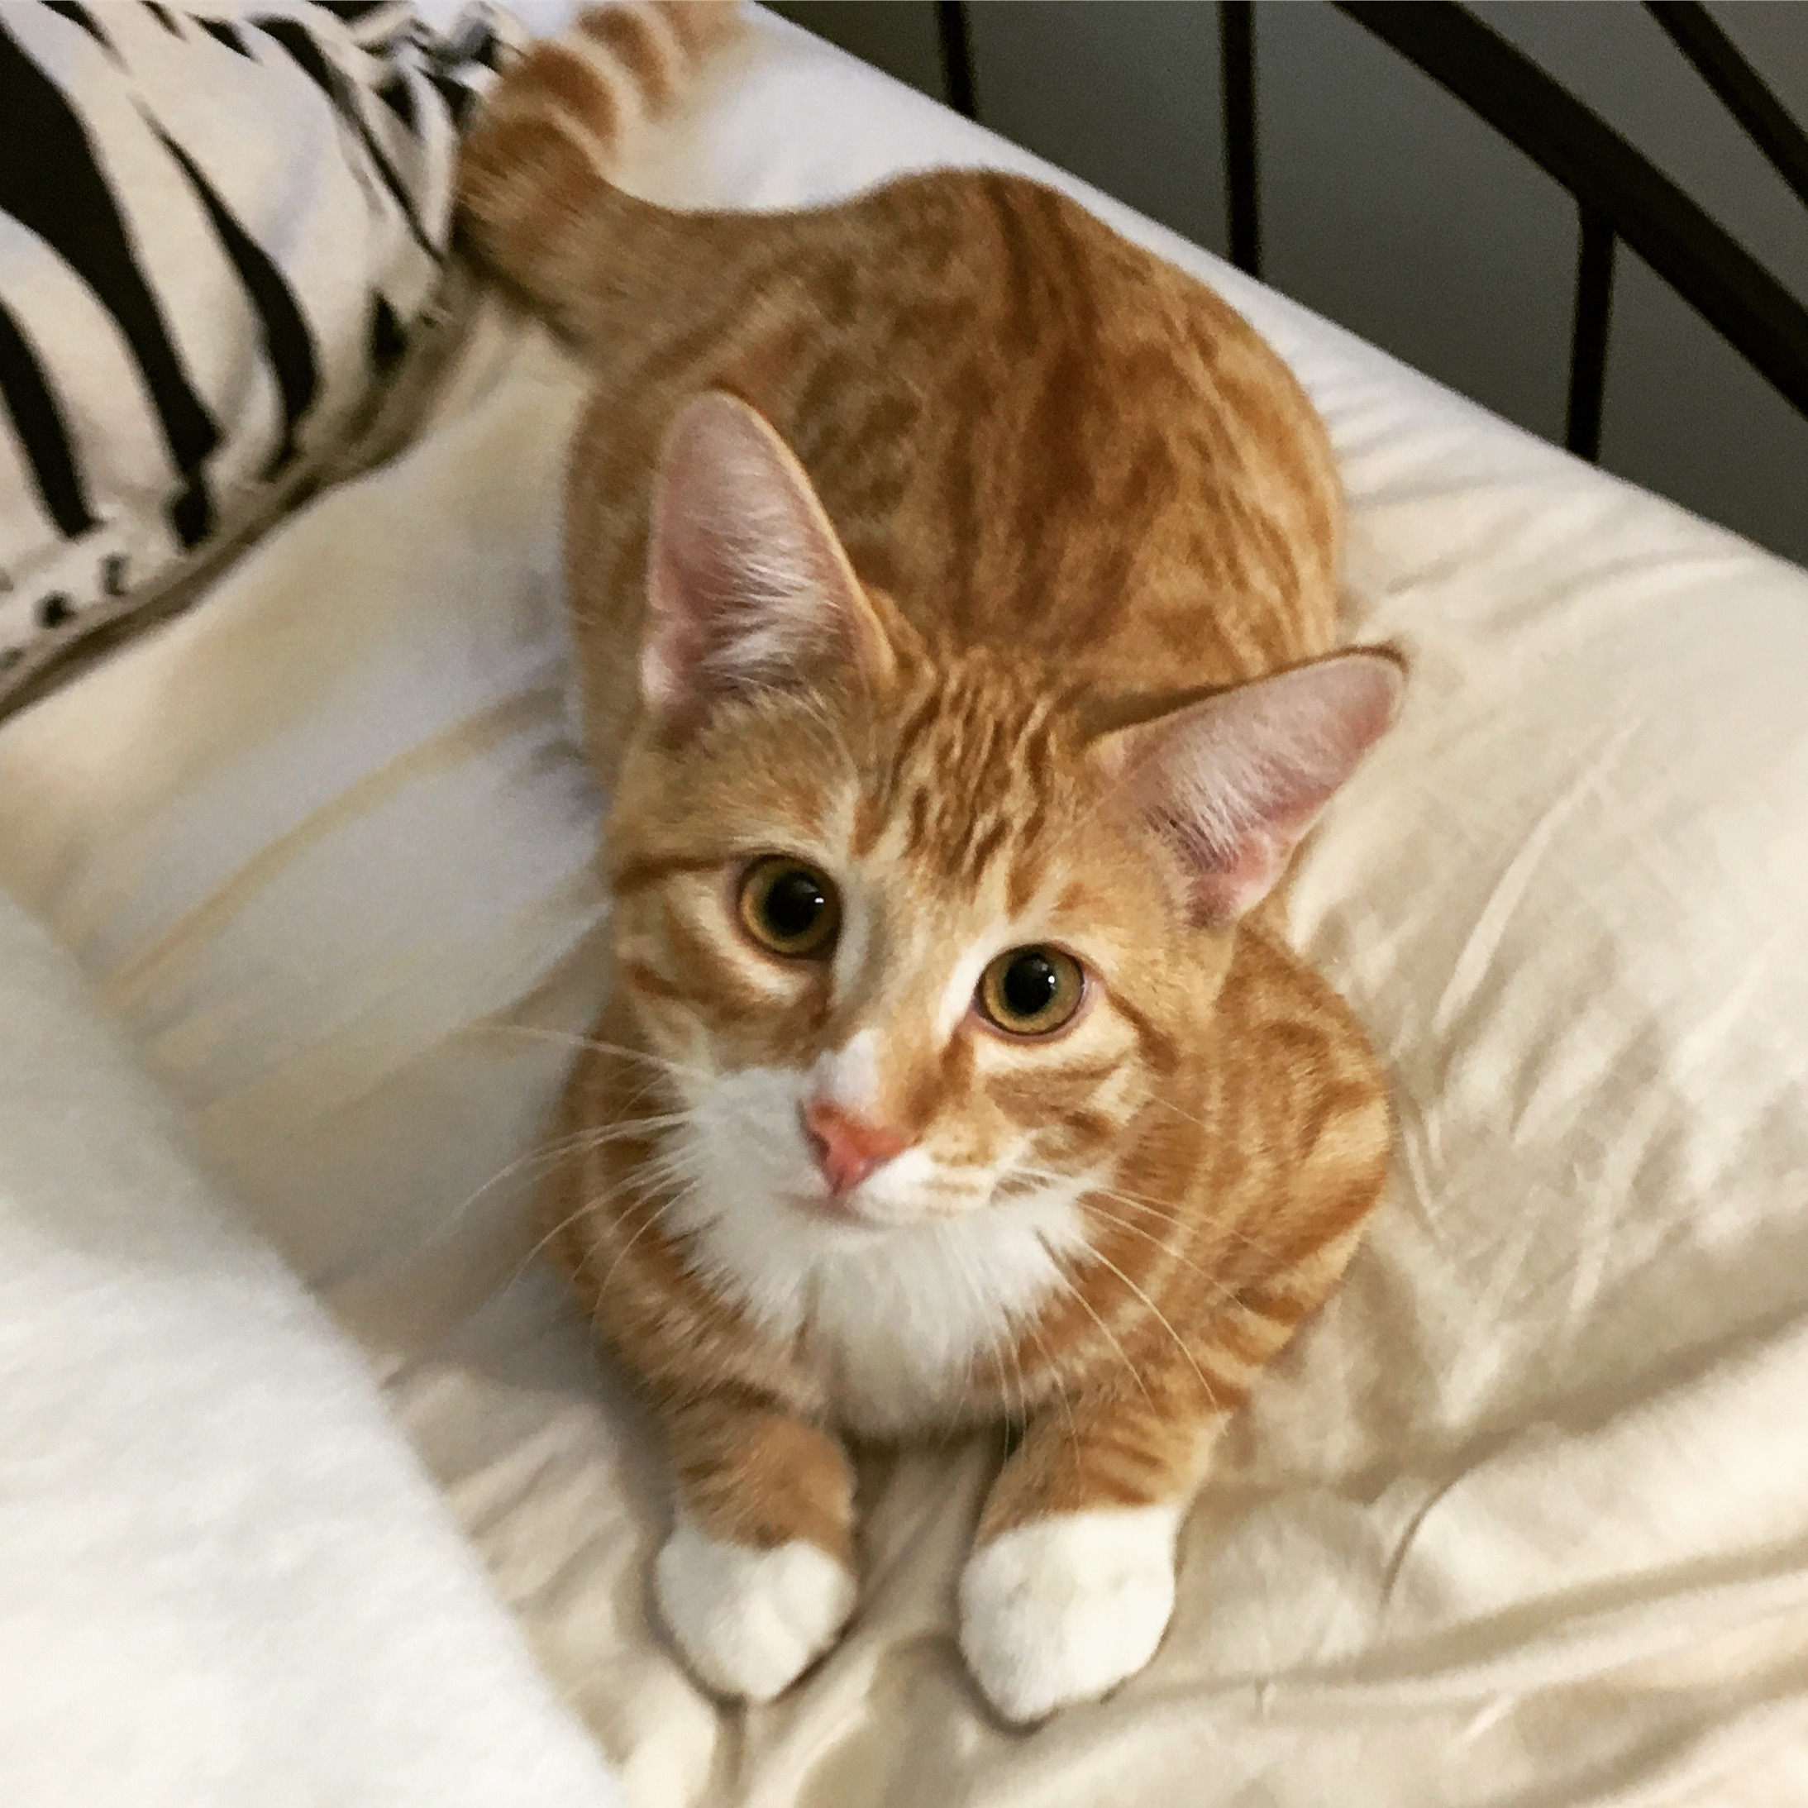
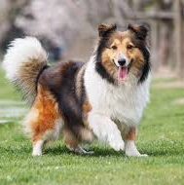
NN
Кот
NN
Собака

Slide 8
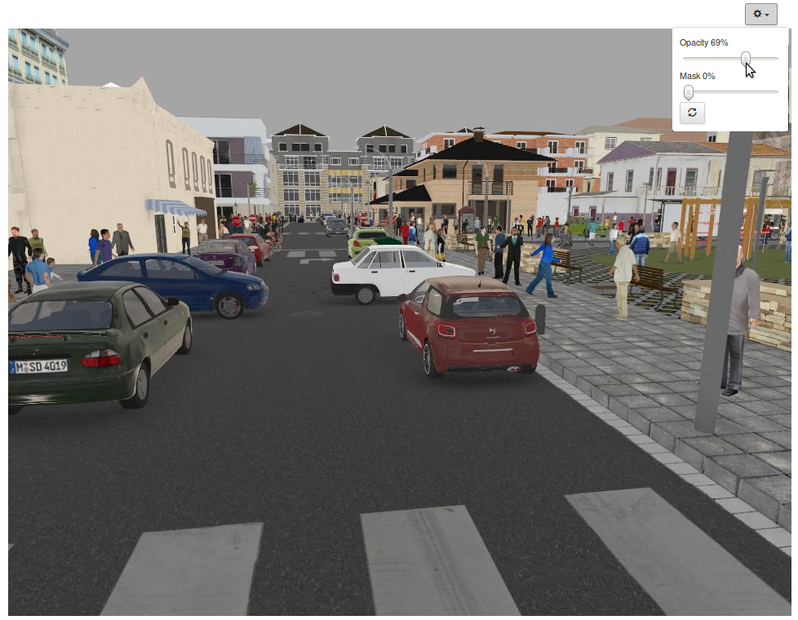
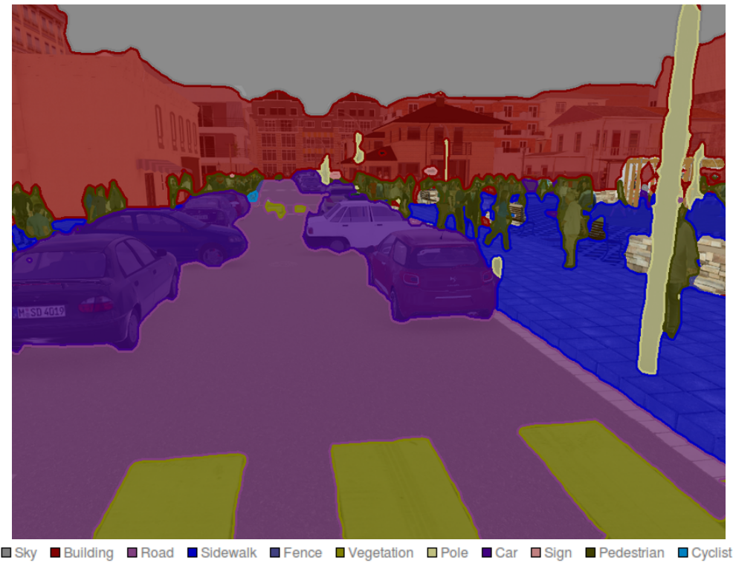
Segmentation
NN

Slide 9
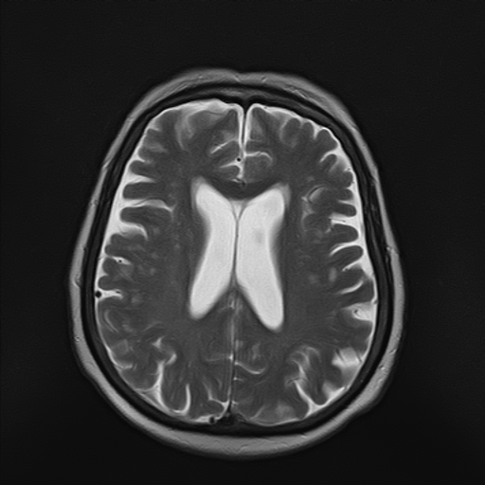

Segmentation
NN

Slide 10
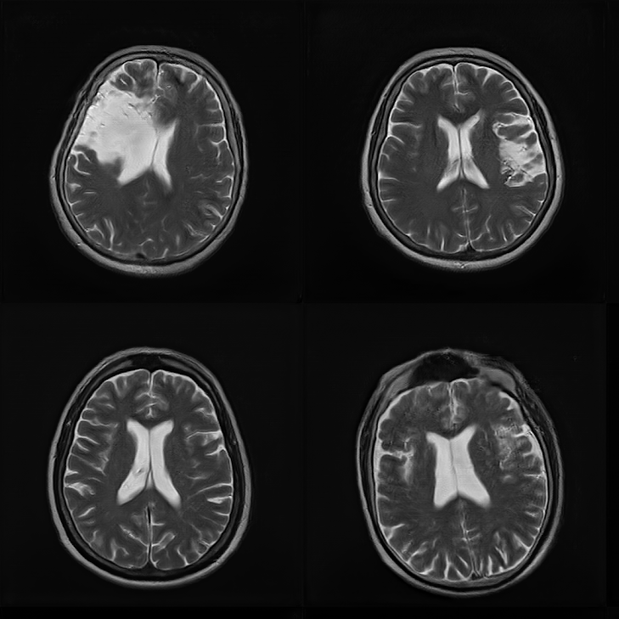
Generation
NN

Slide 11
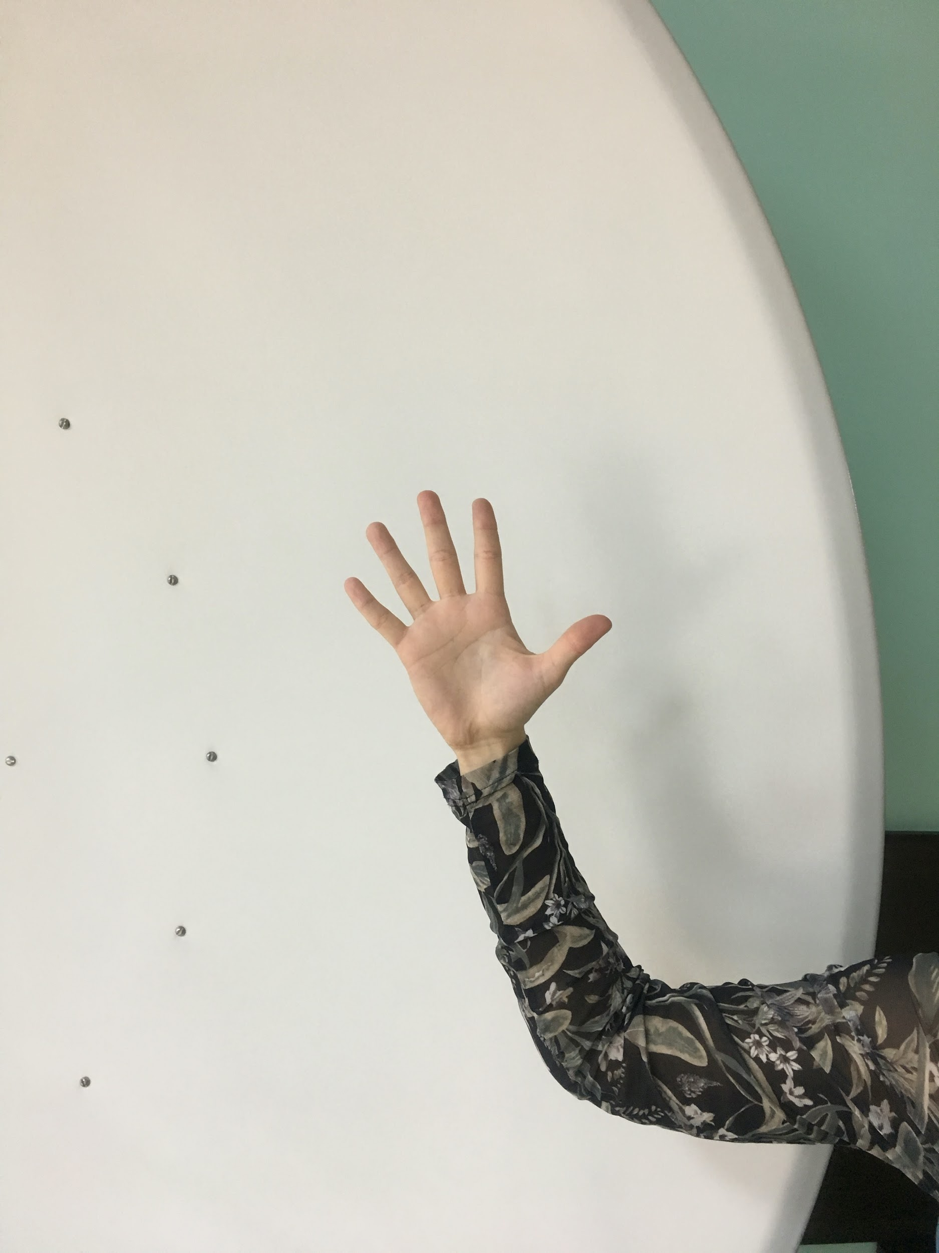
Object detection (Classification + localization)
NN
5

Slide 12
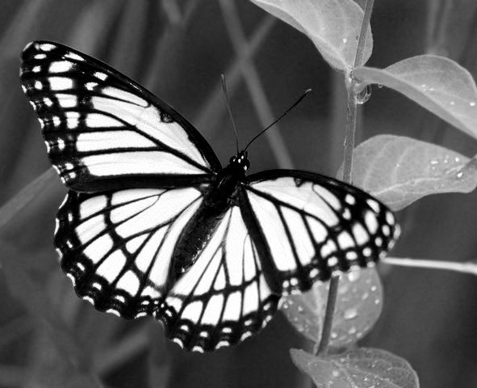
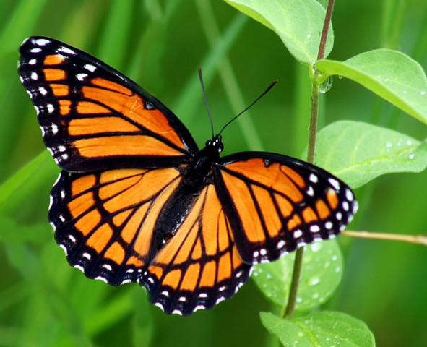
NN

Slide 13
NN
“Мне не понравился этот фильм”
Негативный отзыв

Slide 14
“Памятник Ленину располагается вблизи Оперного Театра”
NN
“Памятник Ленину располагается вблизи Оперного Театра”

Slide 15
f(x)
X
Y

Slide 16
Скаляр
Вектор
Матрица
0.2
(57, 0, 2, 17, 91)
3.2 | 24 | 19
91 | -2 | 4
-13 | 0.3 | -10
3
3

Slide 17
x² + 1
4
17

Slide 18
x₁ + x₂
(3, 2)
5

Slide 19
(x₁₁ - x₁₂ , x₂₁ - x₂₂)
10 25
(-15, 193)
198 5

Slide 20
(x₁₁ - x₁₂ , x₂₁ - x₂₂)
x₁ + x₂
10 25
(-15, 193)
198 5
178

Slide 21
(3x₁₁ - 1x₁₂ - 2x₁₃,
3x₂₁ - 1x₂₂ - 2x_{23,}
3x₃₁ - 1x₃₂ - 2x₃₃)
1x₁ + 2x₂- 6x₃
10 25 34
19 50 23
(-39, 53, -13)
25 90 1
3
3 x 3
-11

Slide 22
...
...
...
(...)
8
8 x 8
?

Slide 23
?
8 x 8

Slide 24
0 | 0 | 3 | 13 | 11 | 7 | 0 | 0
0 | 0 | 11 | 16 | 16 | 16 | 2 | 0
0 | 4 | 16 | 9 | 1 | 14 | 2 | 0
0 | 4 | 16 | 0 | 0 | 16 | 2 | 0
0 | 0 | 16 | 1 | 0 | 12 | 8 | 0
0 | 0 | 15 | 9 | 0 | 13 | 6 | 0
0 | 0 | 9 | 14 | 9 | 14 | 1 | 0
0 | 0 | 2 | 12 | 13 | 4 | 0 | 0
8 x 8

Slide 25
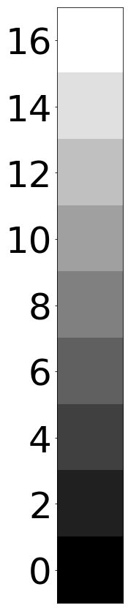

8

Slide 26
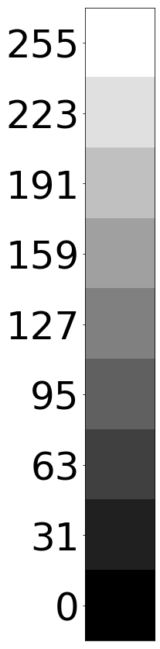
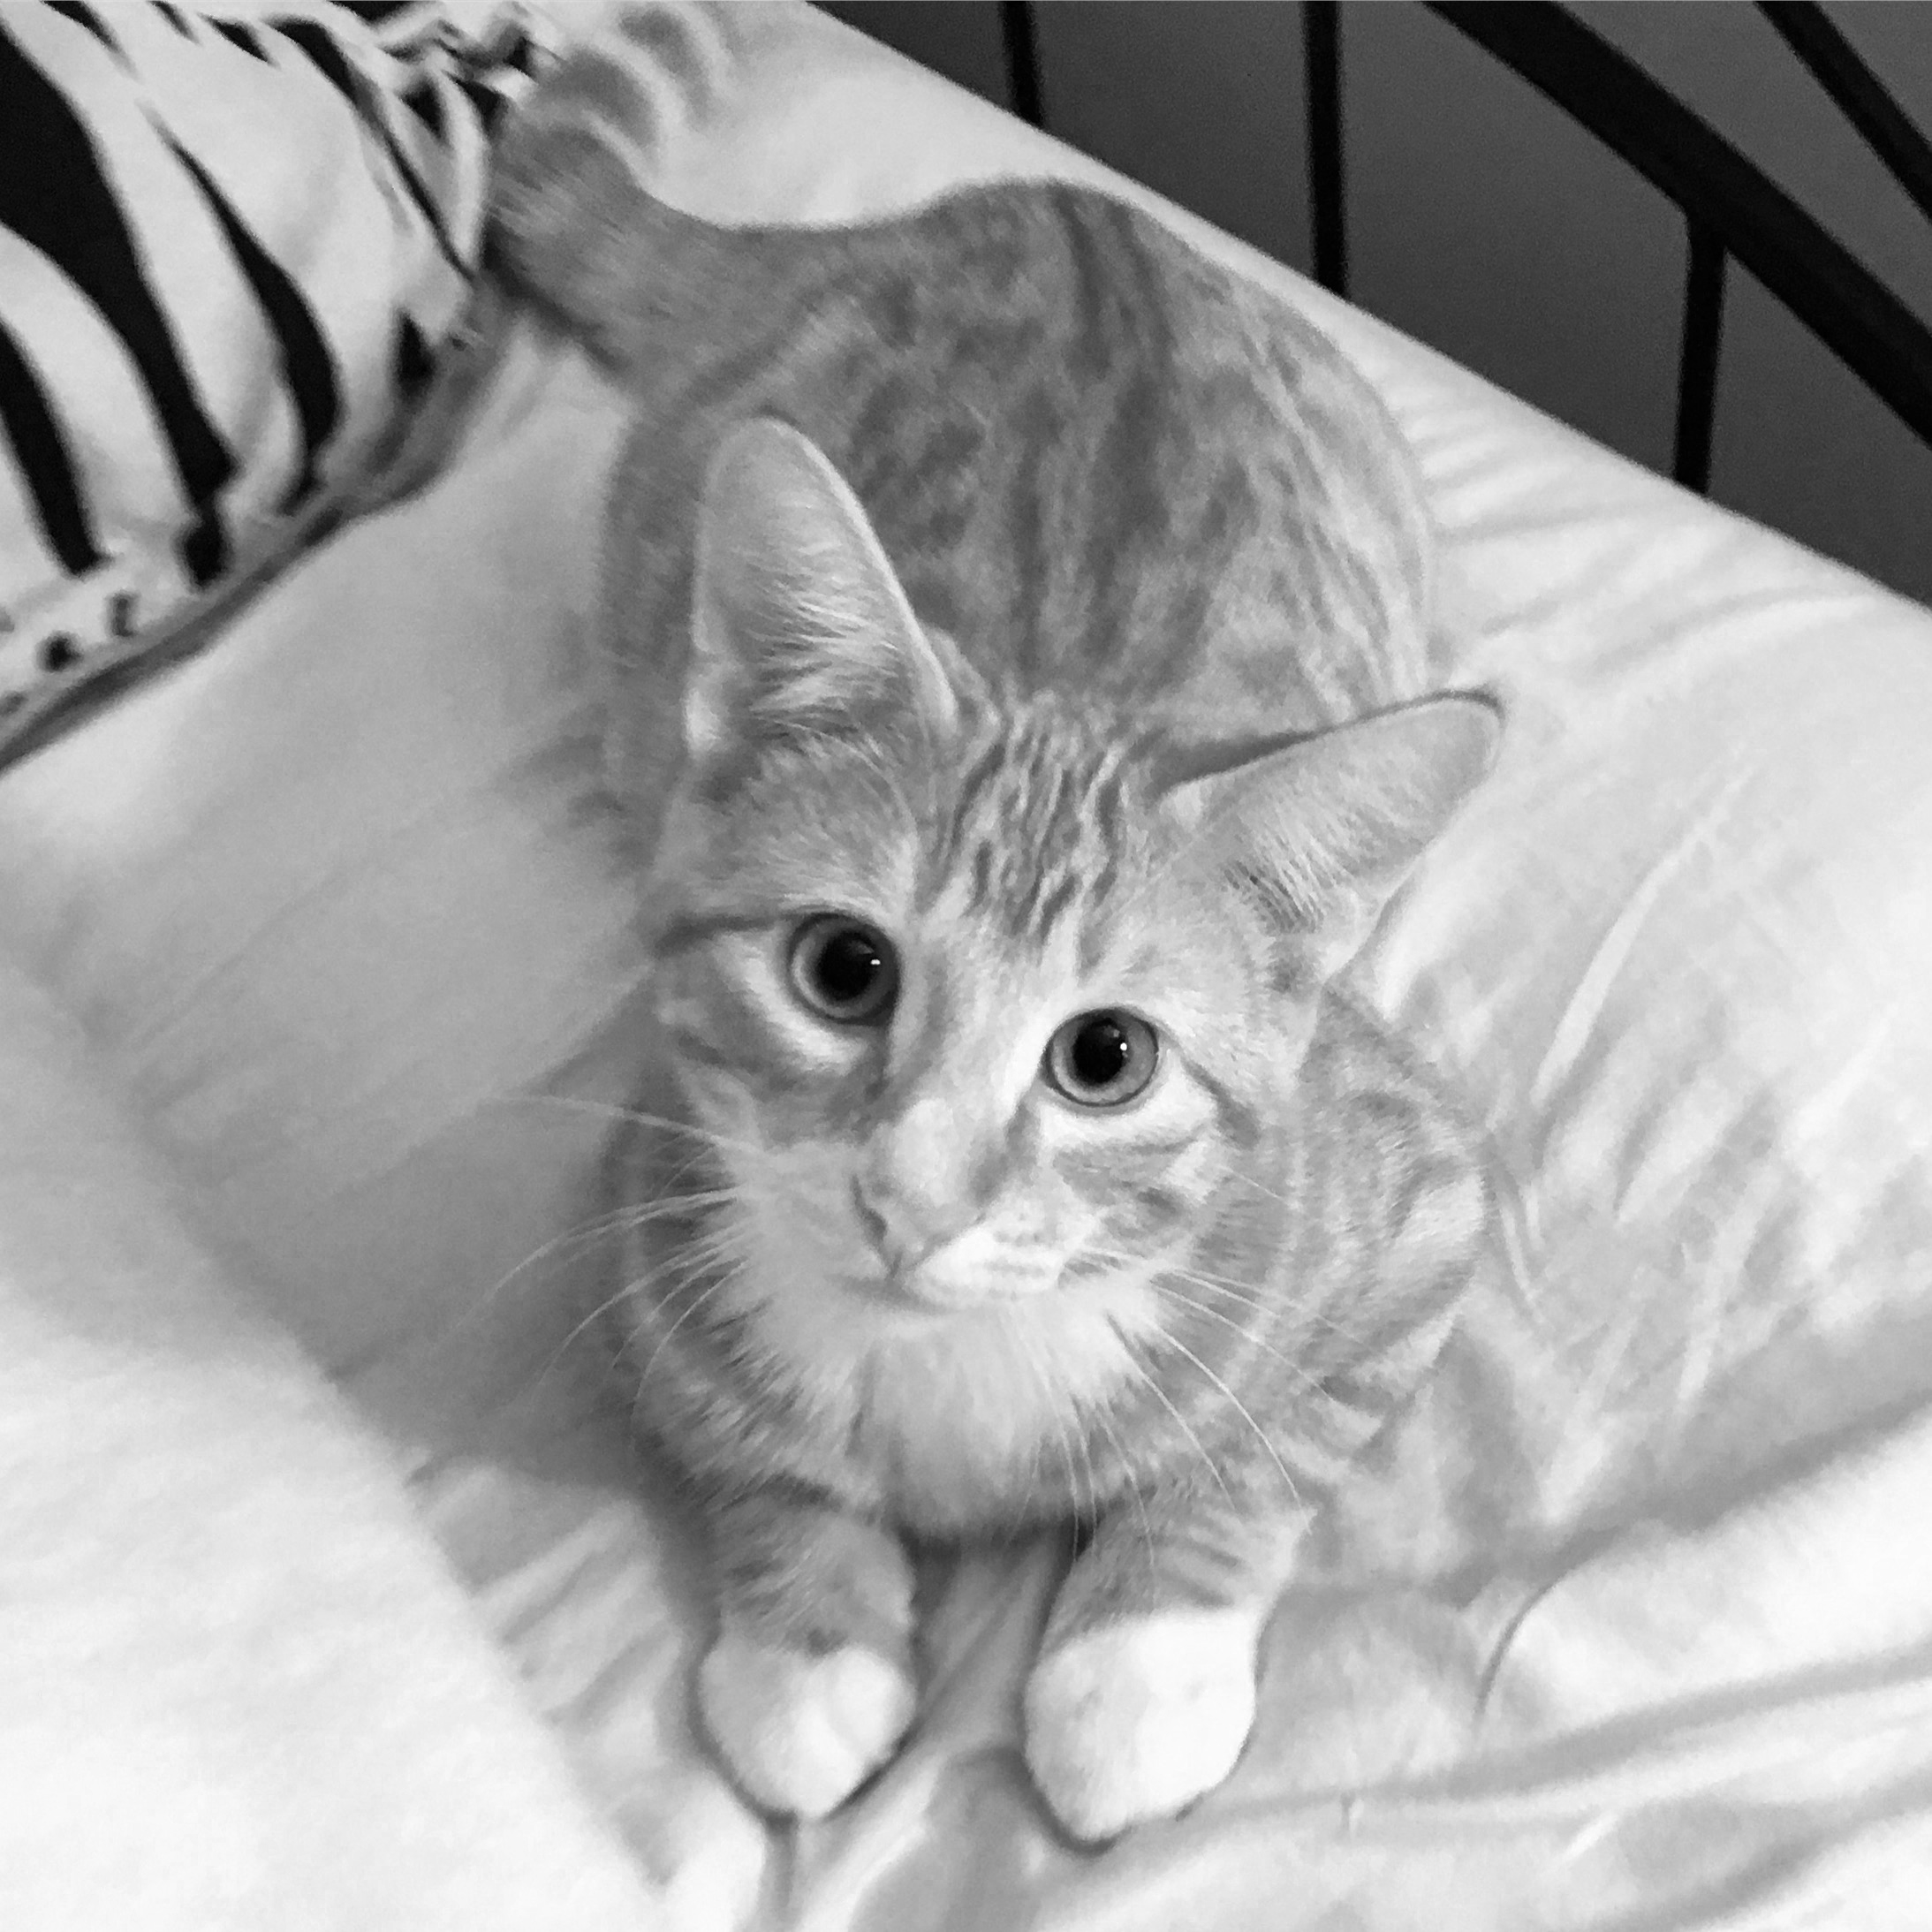
512

Slide 27
Какова вероятность, что на картинке кот?
?

Slide 28
Какова вероятность, что на картинке кот?
1.0

Slide 29
...
...
(...)
512
512 x 512
-5

Slide 30

...
...
(...)
512
512 x 512
-5

Slide 31
...
...
(...)
512
512 x 512
0.006692...
-5
Notes:
Как улучшить результат?

Slide 32
f(x)
0.006692...

Slide 33
W*x*a
0.006692...

Slide 34
Вектор
W*x*a
0.006692...
Матрица
Notes:
Как понять насколько хорошо или плохо отработала модель?

Slide 35
Loss = (prediction - true)²

Slide 36
Loss = (0.006692 - 1.0)² = 0.98666
Notes:
Как мы получили красное значение?

Slide 37
W*x*a
0.006692...
Loss(W,x,a) = (W*x*a - 1.0)²

Slide 38
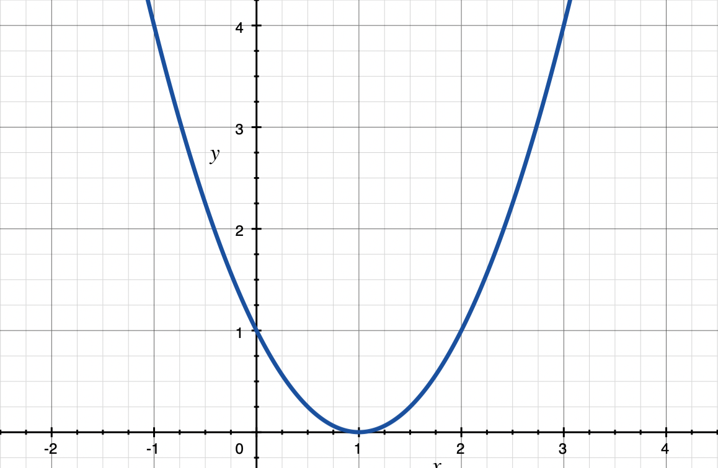
f(x) = (x-1)²

Slide 39
f(x) = (x-1)²
f(2.5) = 2.25

Slide 40
f(x) = (x-1)²
f(2.5) = 2.25
?

Slide 41
f(x) = (x-1)²
f(2.5) = 2.25
f(1.88) = 0.77
Δx

Slide 42
Loss(W,x,a) = (W*x*a - 1.0)² = 0.98666
(ΔW, Δa)
W = W + ΔW
a = a + Δa
W*x*a
0.34589...
Loss(W,x,a) = (0.34589 - 1.0)² = 0.42785

Slide 43
W*x*a
prediction
Loss(prediction, true) = loss
w = w + Δw
a = a + Δa
Δw, Δa

Slide 44
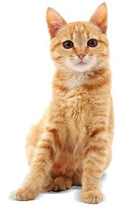
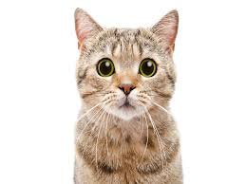
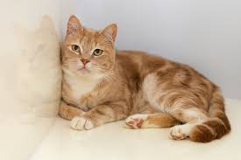
Convolution
...
...
(...)
...
W = W + ΔW
ΔW
Loss(0.006692, true) = loss
0.006692...
-11

Slide 45
TO BE CONTINUED...

